Slide 1
Some find the difference between average and marginal income tax rates confusing.
The marginal tax rate is the part of each additional dollar in income that is paid as tax.
Thus, a married person, filing jointly, with an income of $50,000 will have a marginal tax rate of 15 percent. The 15 percent marginal tax rate should be used to determine after-tax returns on investments.
The average tax rate is simply a person’s total tax payment divided by their total income. It represents the average tax paid on each dollar the person earned.
From Exhibit 2.6, a married person, filing jointly, will pay $6,650 in tax on a $50,000 income [$1,700 + 0.15($50,000 - $17,000)]. This average tax rate is $6,650/$50,000 or 13.3 percent.
Note that the average tax rate is a weighted average of the person’s marginal tax rates paid on each dollar of income. (can you prove it?)

Slide 2
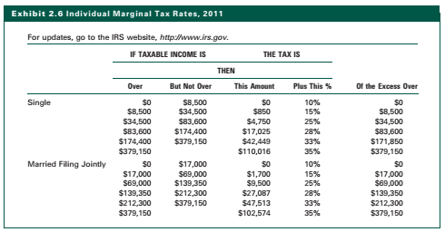

Slide 3
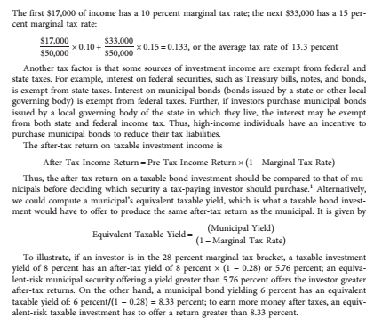

Slide 4
indenture, which is the legal agreement that lists the obligations of the issuer to the bondholder, including the payment schedule and features
Call provisions specify when a firm can issue a call for the bonds prior to their maturity
sinking fund provision specifies payments the issuer must make to redeem a given percentage of the outstanding issue prior to maturity

Slide 5
Secured bonds are the most senior bonds in a firm’s capital structure and have the lowest risk of distress or default
Mortgage bonds are backed by liens on specific assets, such as land and buildings. In the case of default, the proceeds from the sale of these assets are used to pay off the mortgage bondholders.
Collateral trust bonds are a form of mortgage bond except that the assets backing the bonds are financial assets, such as stocks, notes, and other high-quality bonds.
equipment trust certificates are mortgage bonds that are secured by specific pieces of transportation equipment, such as locomotives and boxcars for a railroad and airplanes for an airline.

Slide 6
Debentures are promises to pay interest and principal, but they pledge no specific assets (referred to as collateral) in case the firm does not fulfill its promise. This means that the bondholder depends on the success of the borrower to make the promised payment.
Debenture owners usually have first call on the firm’s earnings and any assets that are not already pledged by the firm as backing for senior secured bonds. If the issuer does not make an interest payment, the debenture owners can declare the firm bankrupt and claim any unpledged assets to pay off the bonds.

Slide 7
Subordinated bonds are similar to debentures, but, in the case of default, subordinated bondholders have claim to the assets of the firm only after the firm has satisfied the claims of all senior secured and debenture bondholders.
That is, the claims of subordinated bondholders are secondary to those of other bondholders.
Senior subordinated, subordinated, and junior subordinated bonds. Junior subordinated bonds have the weakest claim of all bondholders.

Slide 8
Income bonds stipulate interest payment schedules, but the interest is due and payable only if the issuers earn the income to make the payment by stipulated dates.
If the company does not earn the required amount, it does not have to make the interest payment and it cannot be declared in default. Instead, the interest payment is considered in arrears and, if subsequently earned, it must be paid off.
Because the issuing firm is not legally bound to make its interest payments except when the firm earns it, an income bond is not considered as safe as a debenture or a mortgage bond, so income bonds offer higher returns to compensate investors for the added risk.

Slide 9
Corporate Bonds Corporate bonds are fixed-income securities issued by industrial corporations, public utility corporations, or railroads to raise funds to invest in plant, equipment, or working capital.
They can be broken down by issuer (industrial or utility), in terms of credit quality (measured by the ratings assigned by an agency on the basis of probability of default), in terms of maturity (short term, intermediate term, or long term), or based on some component of the indenture (sinking fund or call feature).
Historically, corporate bonds have been substantially less liquid than Treasury or agency bonds, but the difference has declined due to real-time quotes for about 6,000 bonds on the NYSE and improved acquisition alternatives, described by Kim (2007).

Slide 10
An alternative to convertible bonds is a debenture with warrants attached.
The warrant is likewise an option that allows the bondholder to purchase the firm’s common stock from the firm at a specified price for a given time period.
The specified purchase price for the stock set in the warrant is typically above the price of the stock at the time the firm issues the bond but below the expected future stock price.
The warrant makes the debenture more desirable, which lowers its required yield.
The warrant also provides the firm with future common stock capital because when the bond holder exercises the warrant, he/she buys the stock from the firm.

Slide 11
Unlike the typical bond that pays interest every six months and its face value at maturity, a zero coupon bond promises no interest payments during the life of the bond but only the payment of the principal at maturity. Therefore, the purchase price of the bond is the present value of the principal payment at the required rate of return.
For example, the price of a zero coupon bond that promises to pay $10,000 in five years with a required rate of return of 8 percent is $6,756. To find this, assuming semiannual compounding (which is the norm), use the present value factor for 10 periods at 4 percent, which is 0.6756 ….. (THIS IS YOUR ASSIGNMENT TO CALCULATE AT YOUR OWN USING THE PRESENT VALUE CONCEPT)

Slide 12
A Eurobond is an international bond denominated in a currency not native to the country where it is issued. Specific kinds of Eurobonds include Eurodollar bonds, Euroyen bonds, and Eurosterling bonds.
A Eurodollar bond is denominated in U.S. dollars and sold outside theUnited States to non-U.S. investors.
A specific example would be a U.S. dollar bond issued by General Electric and sold in London.
Eurobonds are typically issued in Europe, with the major concentration in London.

Slide 13
Yankee bonds are sold in the United States, denominated in U.S. dollars, but issued by foreign corporations or governments.
This allows a U.S. citizen to buy the bond of a foreign firm or government but receive all payments in U.S. dollars, eliminating exchange rate risk.
An example would be a U.S. dollar-denominated bond issued by British Airways.

Slide 14
International domestic bonds are sold by an issuer within its own country in that country’s currency.
An example would be a bond sold by Nippon Steel in Japan denominated in yen.
A U.S. investor acquiring such a bond would receive maximum diversification but would incur the exchange rate risk of Japanese currency

Slide 15
Special Equity Instruments: Options….equity-derivative securities, which are securities that have a claim on the common stock of a firm.
Options—rights to buy or sell common stock at a specified price for a stated period of time. The two kinds of option instruments are: (1) warrants and (2) puts and calls.
Warrant is an option issued by a corporation that gives the holder the right to acquire a firm’s common stock from the company at a specified price within a designated time period. The warrant does not constitute ownership of the stock, only the option to buy the stock.
Puts and Calls A call option is similar to a warrant because it is an option to buy the common stock of a company within a certain period at a specified price called the striking price. A call option differs from a warrant because it is not issued by the company but by another investor who is willing to assume the other side of the transaction.
Options also are typically valid for a shorter time period than warrants. Call options are generally valid for less than a year, whereas warrants often extend more than five years. The holder of a put option has the right to sell a given stock at a specified price during a designated time period. Puts are useful to investors who expect a stock price to decline during the specified period or to investors who own the stock and want hedge protection from a price decline.

Slide 16
Money Market Funds
Bond Funds
Common Stock Funds
Balanced Funds
Index Funds

